Slide 1
Motion Sensor for Occupancy Detection
ESW Monsoon-22
YYAT Yet Another Team

Slide 2
MOTIVATION
00
The motivation is to train our system using a real camera and ML algorithms as the ground truth to make the system more accurate and reduce the amount of False OFFs. The system can infer wrong data because of some particular circumstances (depending on what sensor is used) which causes the reading to be wrong resulting in wrong actions taken by the system.

Slide 3
IMPLEMENTATION
01
We will be using a Grid Eye Infrared Sensor to monitor the occupancy of any room the device is placed in. It will be trained using a simple ML algorithm. Accurate data points are obtained by initially using an Arduino Camera. Accuracy is improved by reducing the number of false OFFs and false ONs. Data will be sent to Thingspeak and OM2M.

Slide 4
IMPLEMENTATION
Step 2
Step 4
Step 1
Step 3
Use the data obtained to train the system using simple ML algorithms with the camera as the ground truth.
Build the circuit and further, setup and get hands-on with the hardware.
Collect data overtime and check the accuracy of the model, obtaining data for analytics in the process.
Collect data from the camera and grid eye sensor and send the data to ThingSpeak and oneM2M for further processing.

Slide 5
A deeper insight in Implementation
Host a web server, to which the microcontroller will make requests to send data.
Use OM2M and Thingspeak to communicate the data.
After the training phase is complete, provide an API which the microcontroller can use to determine if the data collected corresponds to ON or OFF.
Add the functionality of training the ML model to the web server.

Slide 6
DATA ANALYTICS
02
Collect -
> Density of people for time of day
> Time of peak usage
> Number of false OFFs and false ONs
> Accuracy of Model

Slide 7
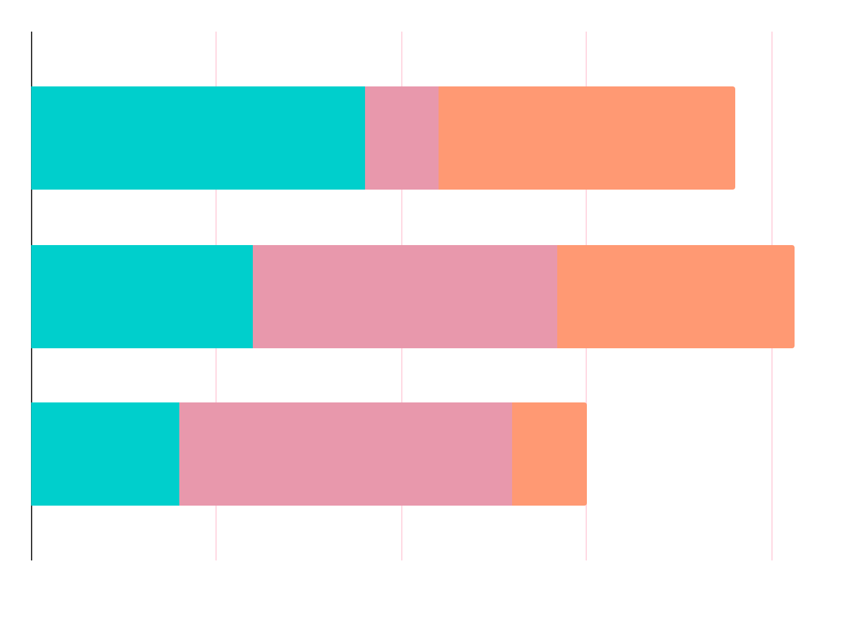
DATA ANALYTICS
Accuracy
Occupancy
Inaccuracy
Measure the accuracy of our model over time
Number of people in the room with time
Number of false OFFs and false ONs over the day

Slide 8
SUMMARY
03
By the end of this project we aim to train an ML model to accurately determine whether a person is present or not.
We use standard IoT protocols to communicate the data, and process it to train the model and generate an API which can be used to interface with the model.

Slide 9
Team-YYAT Yet Another Team
Divij D
Bhargav Srinivas K
Ishwar B Balappanawar
Sreeram RV

Slide 10

THANKS

